Slide 1

Energy Consumption and Production Analysis
SDG 12: Responsible consumption and production
Unique ID: IBM3814
Team Name: Vision
University Name: University of Engineering and Management, Kolkata

Slide 2
Agenda
1
2
3
4
5
Introduction
Problem Statement
Processing
Outcomes
Conclusion

Slide 3
Meet our Team Vision
Shanu Kumar Manglam
Shubhajit Maji
Rajnish Kumar
Sabnam Muskan

Slide 4
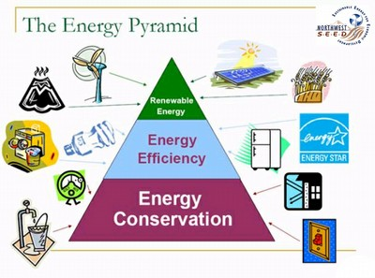
Introduction
Energy conservation and consumption are vital for sustainable development. Efficient energy use reduces environmental impact and conserves resources for future generations. Understanding consumption patterns and implementing conservation measures are key to achieving global sustainability goals.

Slide 5

Problem Statements
Energy consumption and production are crucial for economic development and sustainability.
Emphasis on renewable energy and reducing carbon footprints.
Need to understand and predict future energy trends.
Analyzes data on primary energy, electricity, fossil fuels, and renewables.
Develops predictive models for actionable insights in energy policy and planning.

Slide 6
Objectives of the Project
Data Preparation and Cleaning
Provide insights derived from the data analysis and model predictions to inform policy and decision-making.
Exploratory Data Analysis (EDA)
Provide insights derived from the data analysis and model predictions to inform policy and decision-making.
Feature Engineering
Select and engineer features that are most relevant for predicting energy consumption.
Model Development
Develop and train machine learning models to predict future energy consumption based on historical data.
Insights
Provide insights derived from the data analysis and model predictions to inform policy and decision-making.

Slide 7
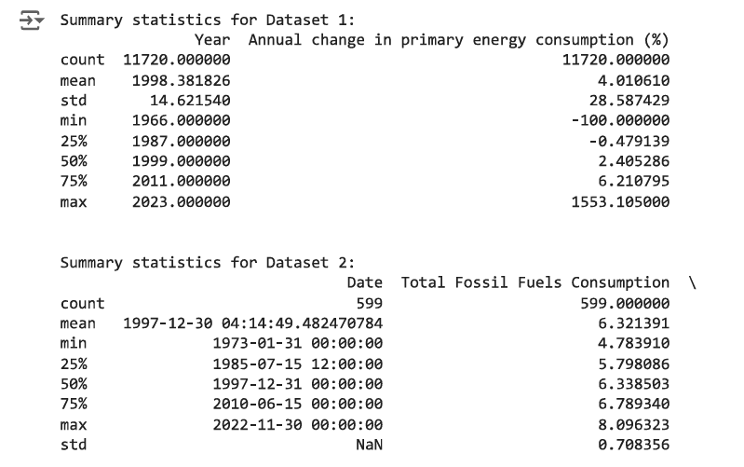
Processing: 1

Slide 8
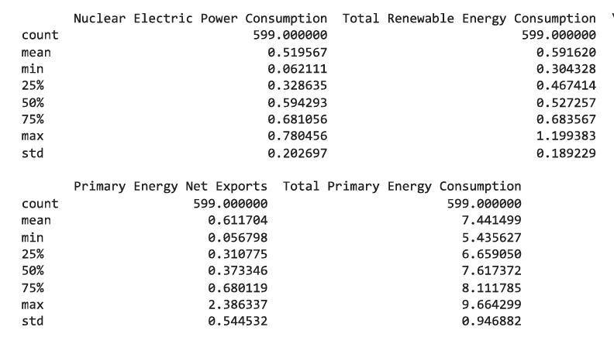
Processing: 2

Slide 9
Features
Change in Energy Consumption: Annual percentage change in primary energy.
Consumption: Fossil fuels, nuclear power, renewables, net exports, and total consumption.
Global Energy Substitution: Energy from various sources (e.g., renewables, fossil fuels).
Primary Energy Consumption: Total in TWh.
Production: Fossil fuels, nuclear power, renewables, imports, and total production.
Renewable Energy Share: Share of renewables in total consumption.

Slide 10
Tools for Analysis
Python: For data cleaning, analysis, and visualization, using libraries such as Pandas, NumPy, Matplotlib, and Seaborn.
Jupyter Notebooks: For documenting the analysis process and visualizations.
Scikit-learn: For developing predictive models and machine learning algorithms.

Slide 11
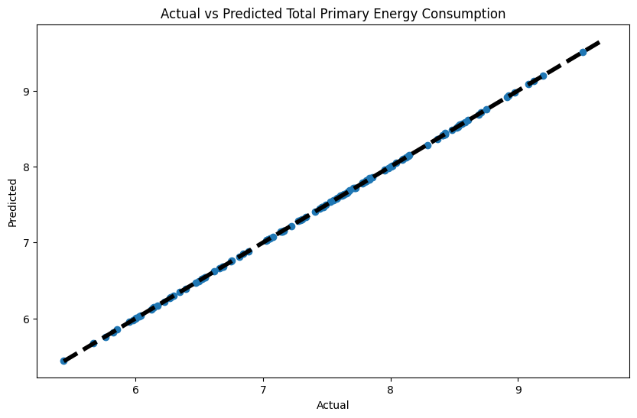
Outcomes: 1

Slide 12
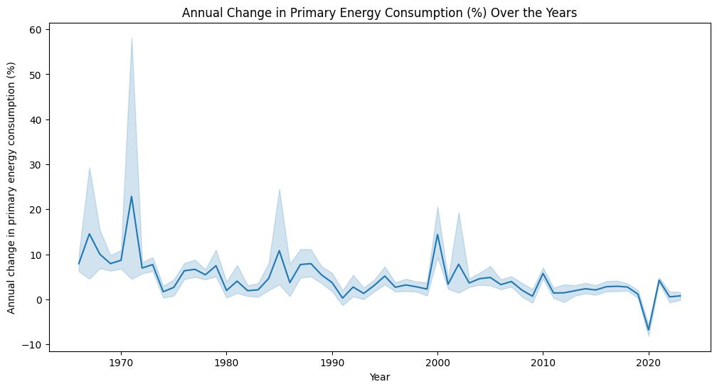
Outcomes: 2

Slide 13
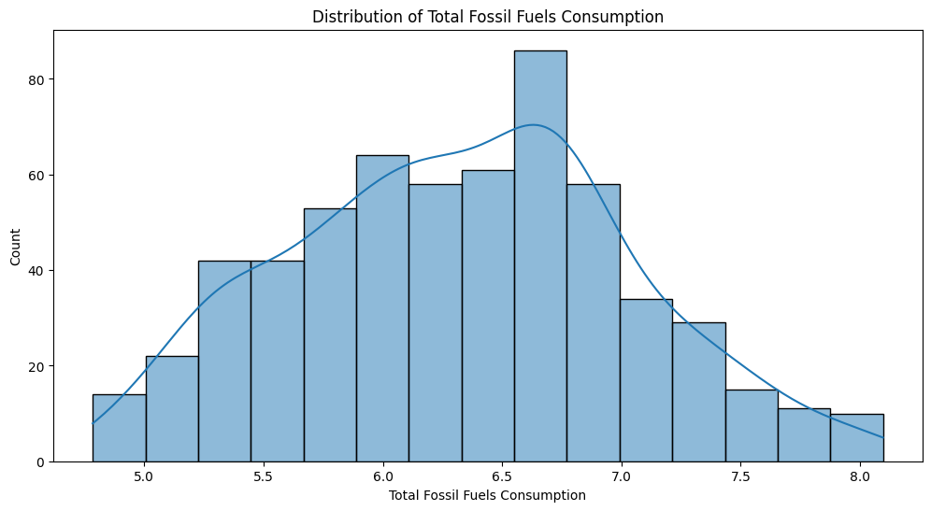
Outcomes: 3

Slide 14
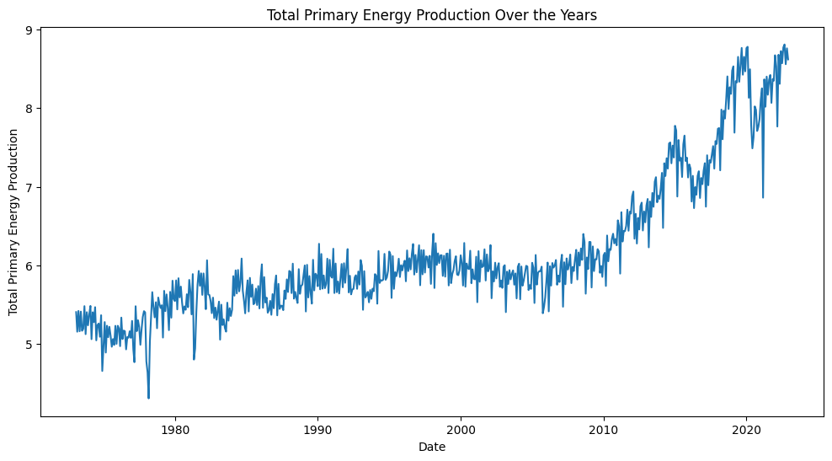
Outcomes: 4

Slide 15
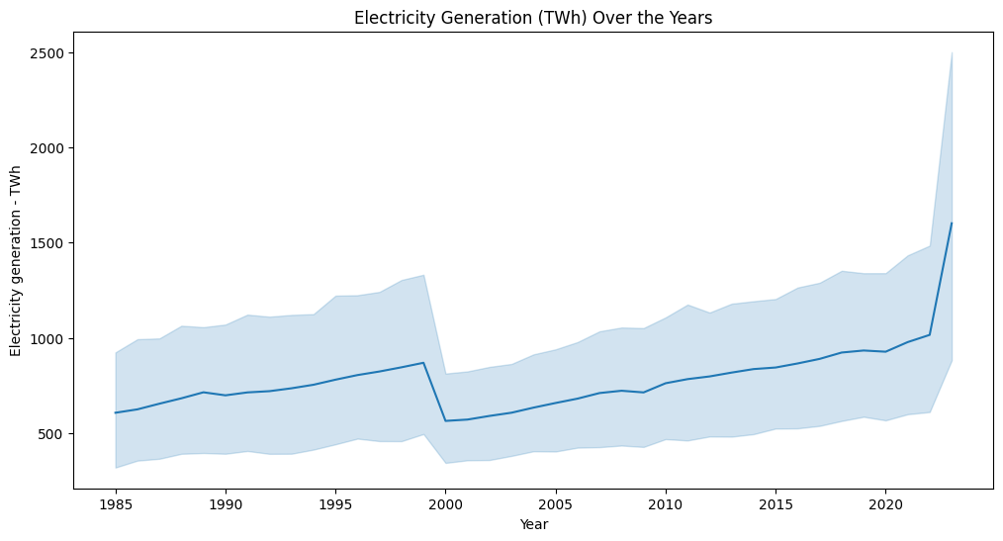
Outcomes: 5

Slide 16
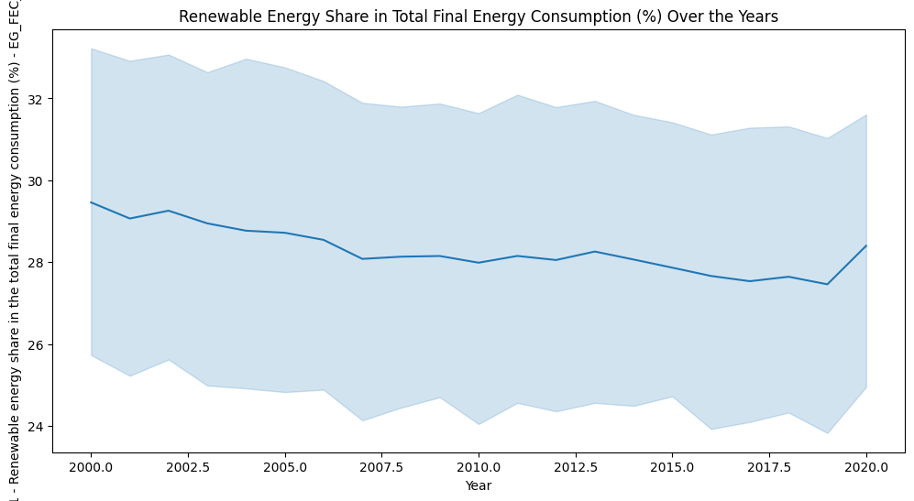
Outcomes: 6

Slide 17
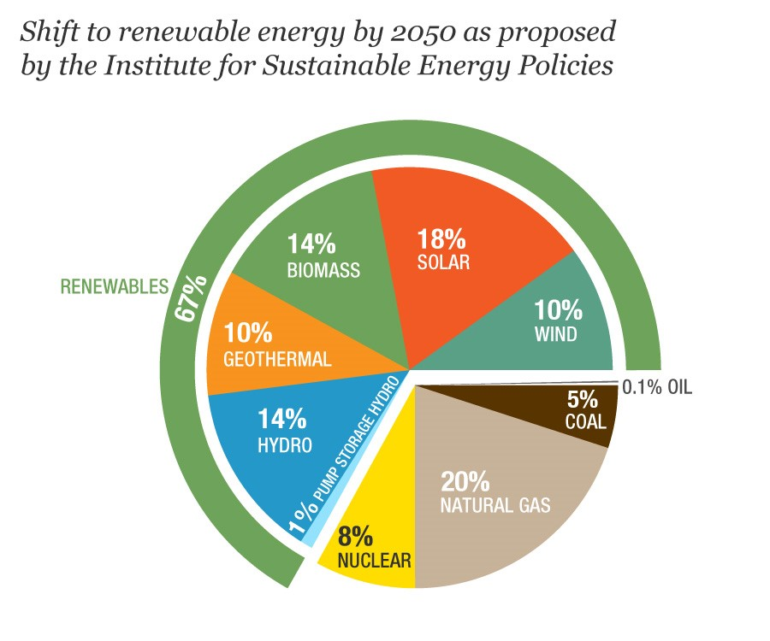
Conclusion
This model will aid in refining energy strategies by delivering precise predictions and insights. It will enhance decision-making processes, support the adoption of sustainable practices, and enable proactive management of future energy challenges.

Slide 18
Sources of Data
OurWorldinData: Energy Production and Consumption- https://ourworldindata.org/energy-production-consumption
OurWorldinData: Ensure access to affordable, reliable, sustainable and modern energy for all- https://ourworldindata.org/sdgs/affordable-clean-energy
Kaggle: Global Electricity Demand and Generation Dataset- https://www.kaggle.com/datasets/shahriarkabir/global-electricity-demand-and-generation-dataset
Kaggle: Renewable Power Generation and weather Conditions- https://www.kaggle.com/datasets/pythonafroz/renewable-power-generation-and-weather-conditions

Slide 19
Thank you
Team Vision

